Slide 1
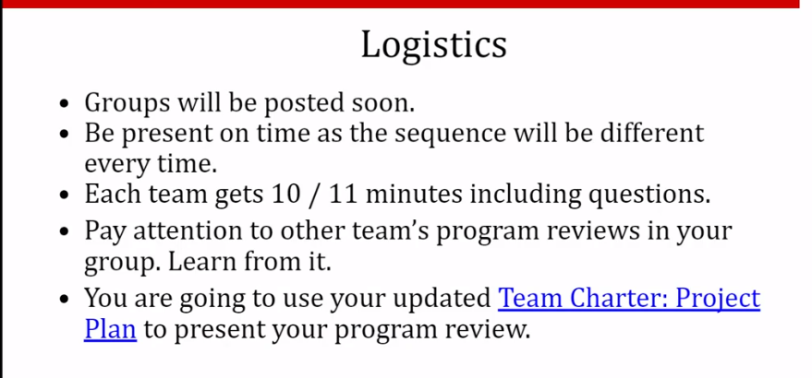
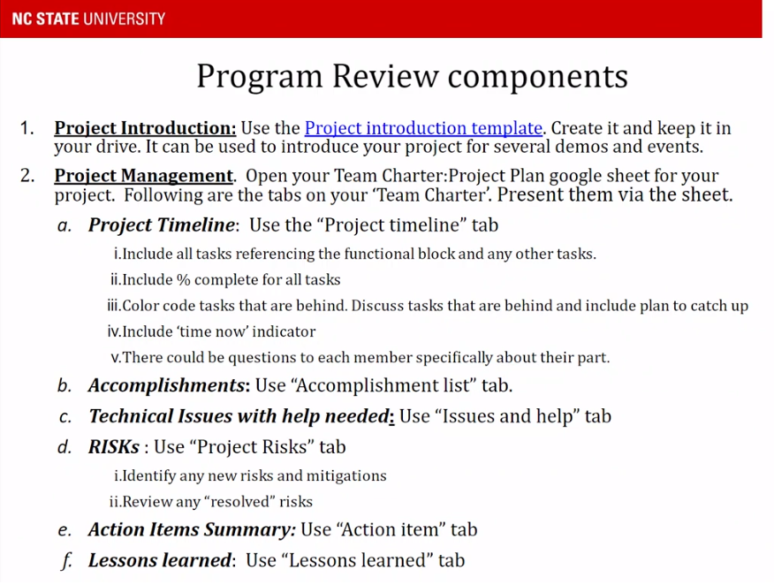
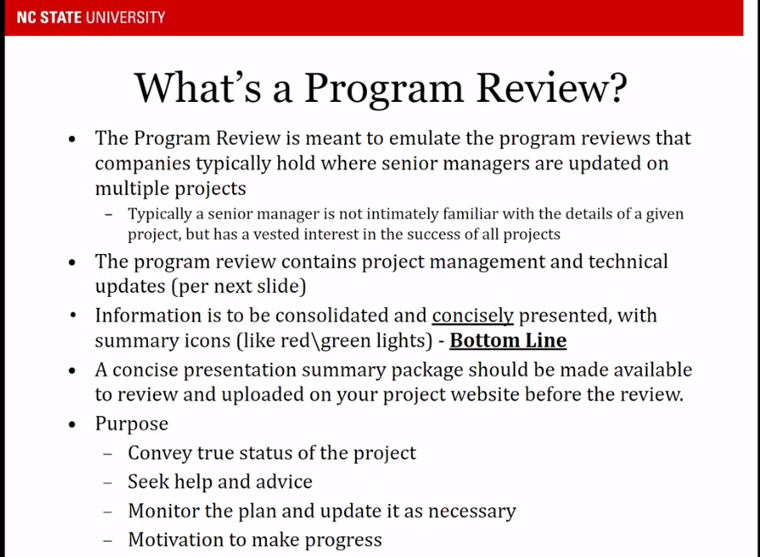

Slide 2
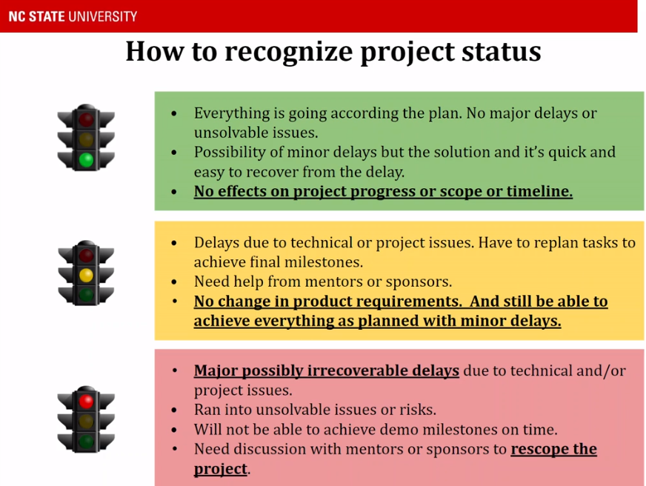
Choose 1 stoplight color to put on the introduction slide to qualify the status of the whole project

Slide 3
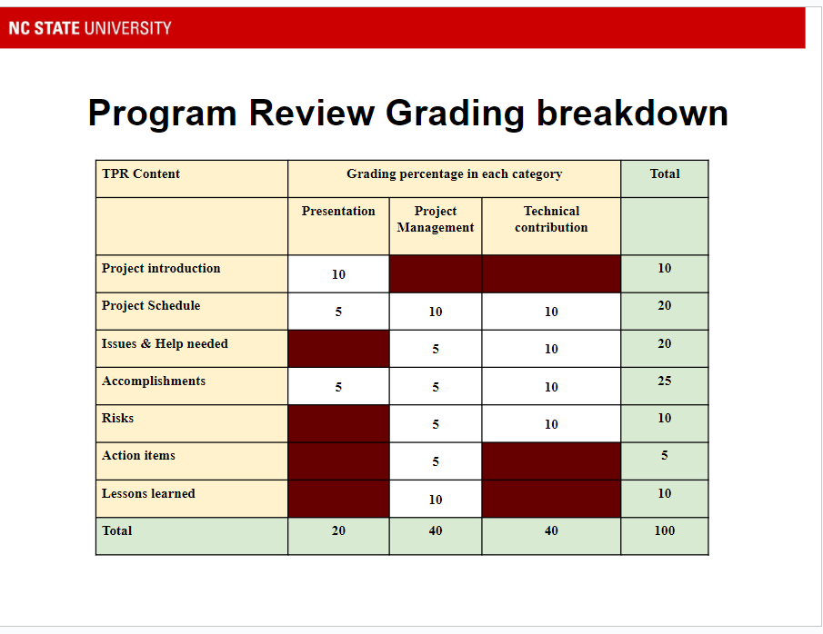
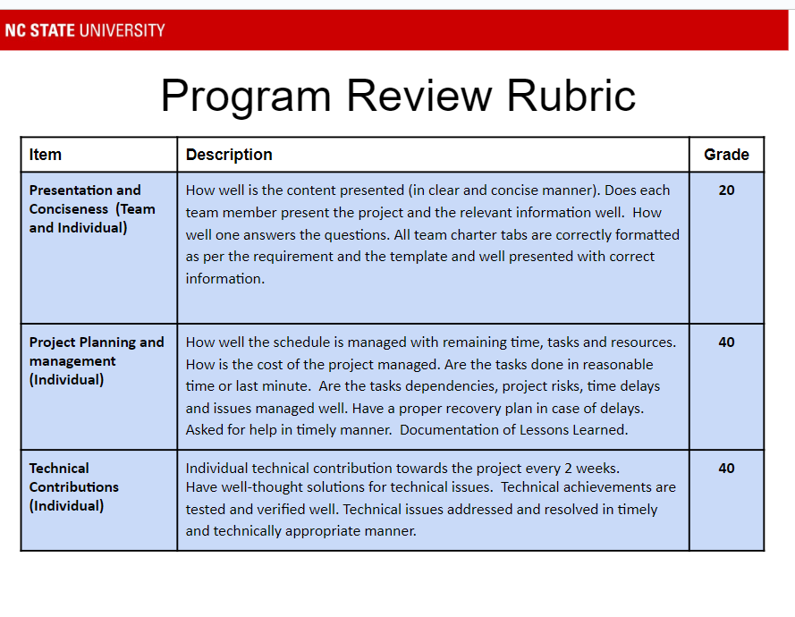

Slide 4
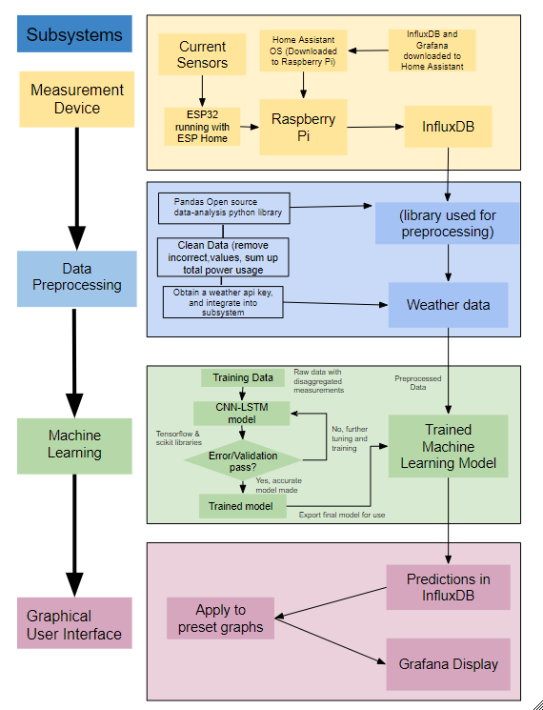

Project Introduction (Program Review 1)
Residential Power Disagreggation - Team 50
Team: Andrew Bailey, Ralph Cullom, Manny Harris, Labib Kasim
Sponsor: Huangjie Gong (ABB)
Key features:
Device measures lumped power usage of a household.
Data is wirelessly transmitted to a database
Weather data is added
Machine learning algorithm disaggregates loads
Information is displayed to the user
Key Requirements:
Inexpensive
Size
User interface
Target Customers
Homeowners & Property Managers
Project issues/bottlenecks:
-Home assistant install
-Weather & preprocessing
Notes:
Andrew
Key Features
Our device measures the total power usage of a household and then uses software to predict how much power each individual appliance used before displaying that info to the user. After using current transformers to measure the total power, the measurements are wirelessly sent to a database. Then, a weather API adds the temperature for the time the measurement was taken, and a machine learning algorithm disaggregates the total power into separate loads. After this is done, the total and disaggregated loads are displayed to the user on a graphical interface
Key Requirements
Inexpensive - Our project differs from other devices in price, with an estimated final cost of the product under $100.
Size - device shall be small enough to fit inside a residential distribution panel
User interface - The user should be able to comprehend the data displayed without a technical background
Target Customers & Usage
Homeowners using this device will be able to understand their power usage and can find which appliances may be upgraded to save money on their electricity bill. Property managers could do this on a much larger scale if they have multiple housing units they maintain

Slide 5
Team Charter - Project 50
Project Schedule
Issues & Help needed
Accomplishments
Risks
Action Items
Lessons Learned

Slide 6
Accomplishments

Slide 7
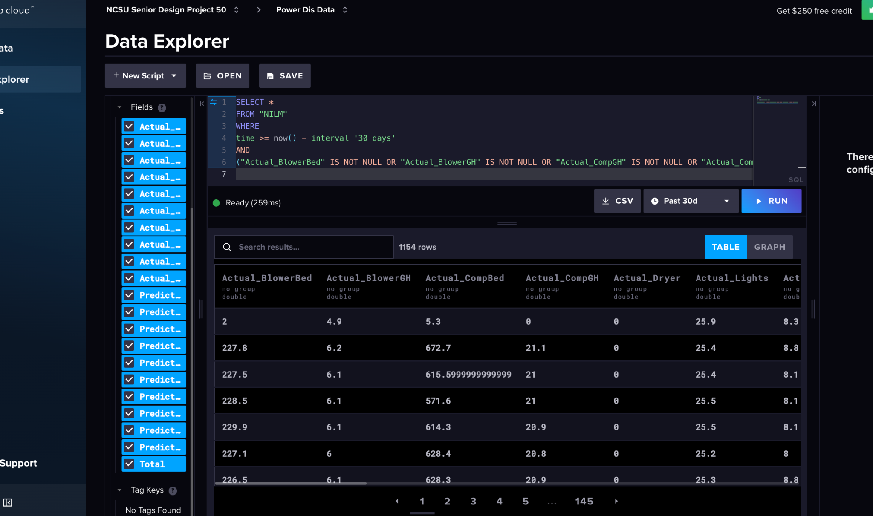
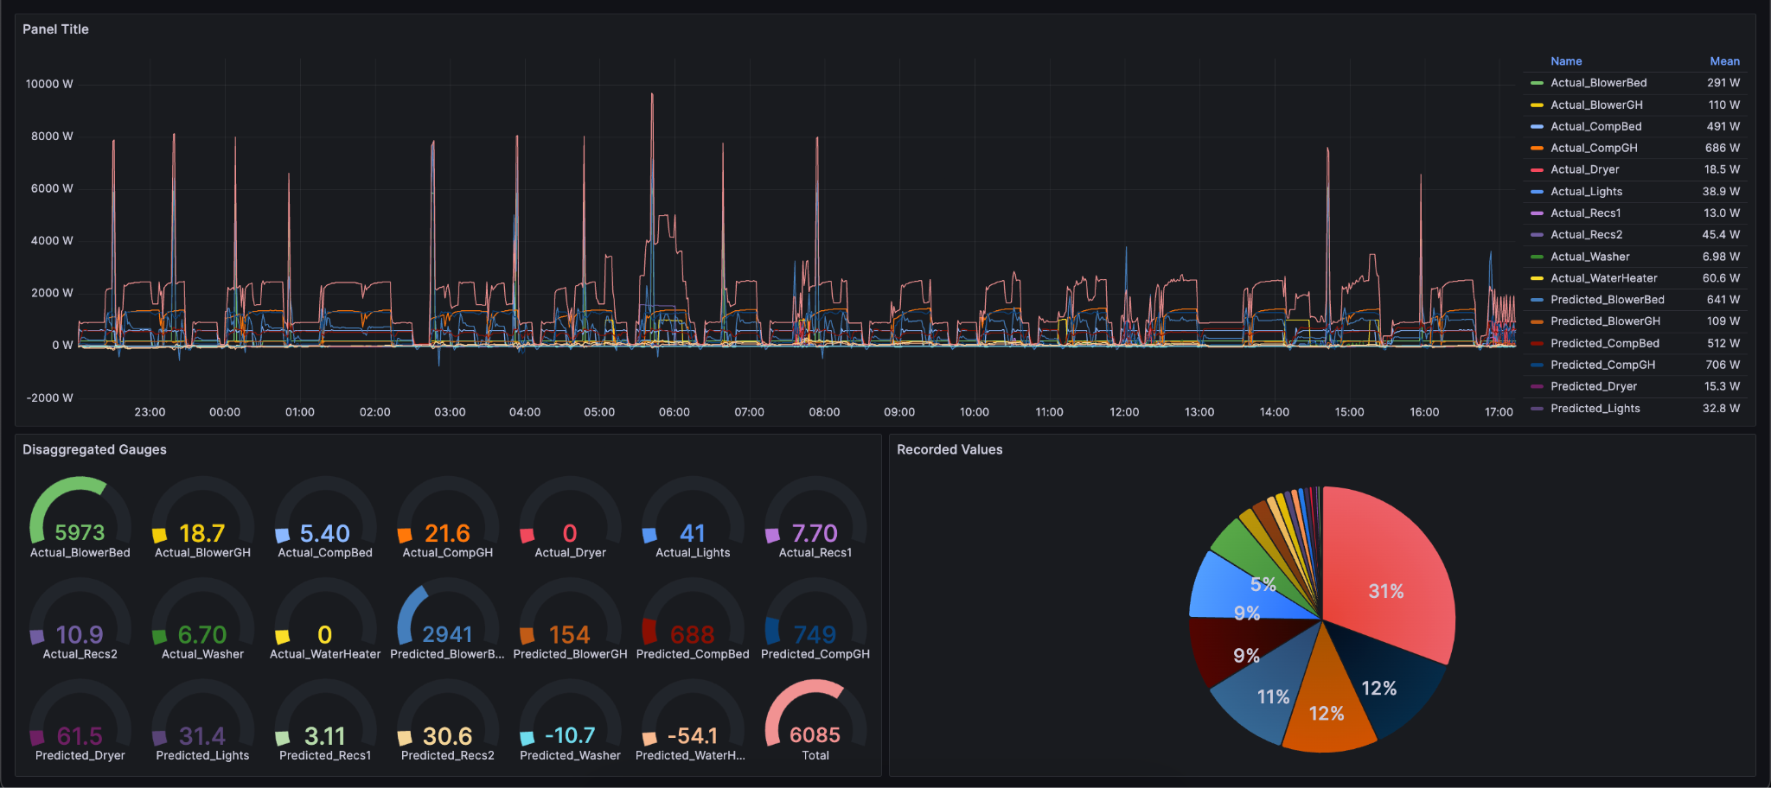
Ralph
Preset graphs (temporary)
InfluxDB and Grafana connection
Grafana!

Slide 8
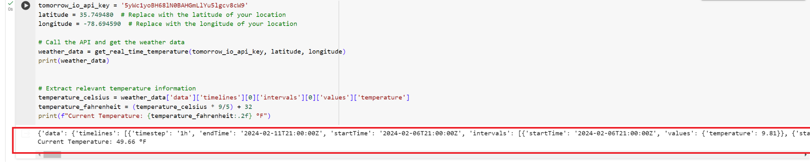
Labib
Linked real time weather information from a weather API to InfluxDB.
Fetched predicted weather forecast for the next 5 days.
Preprocessed data by removing null and negatives.
Link to the collab file https://colab.research.google.com/drive/1x6T5m0O6rmfWPAxP0Uw_xx8MkC_H1LGj?authuser=1#scrollTo=NPz1hi4GPs-j

Slide 9
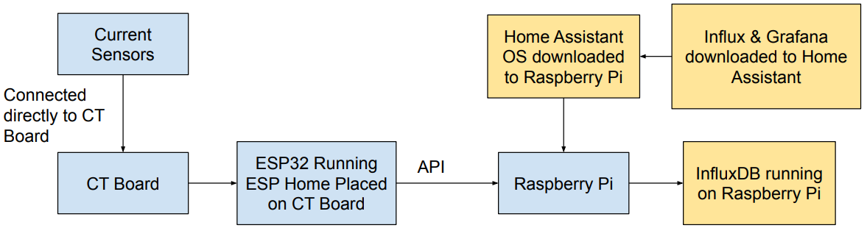
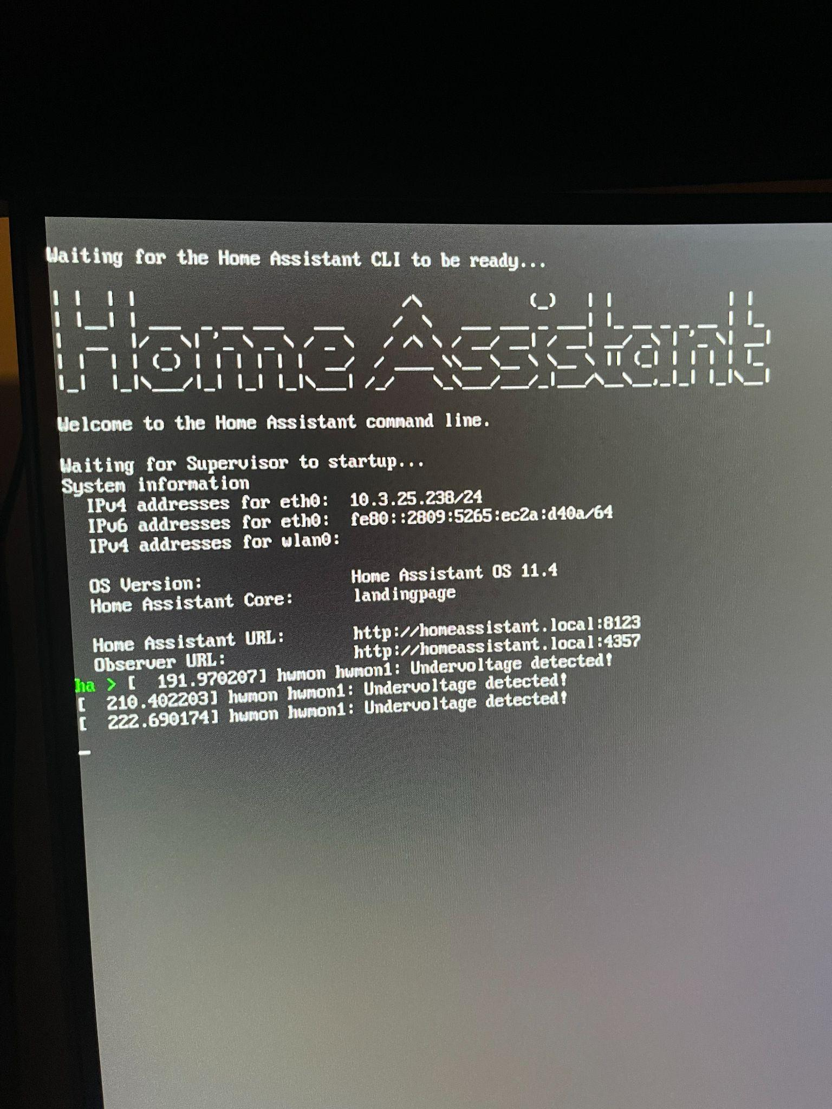
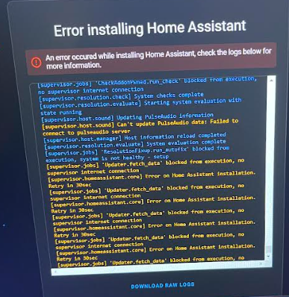
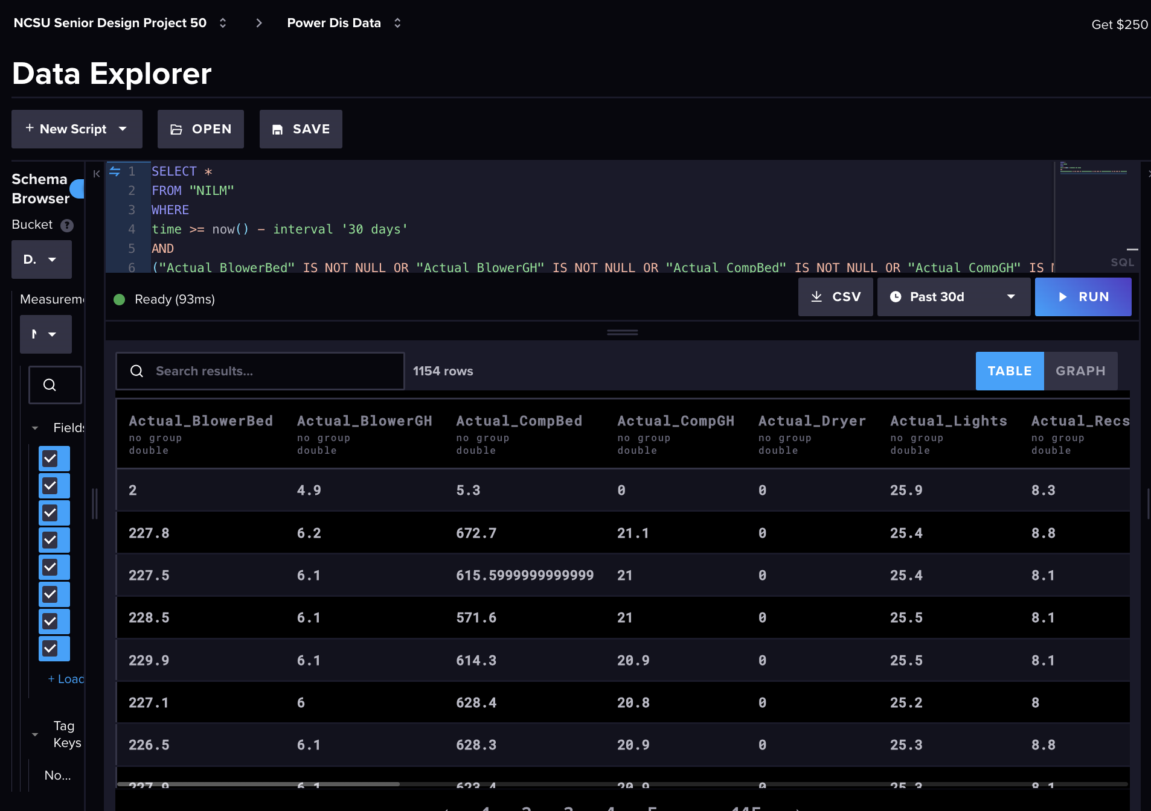
Manny
Establish communication connections
Adapt when necessary to different software

Slide 10
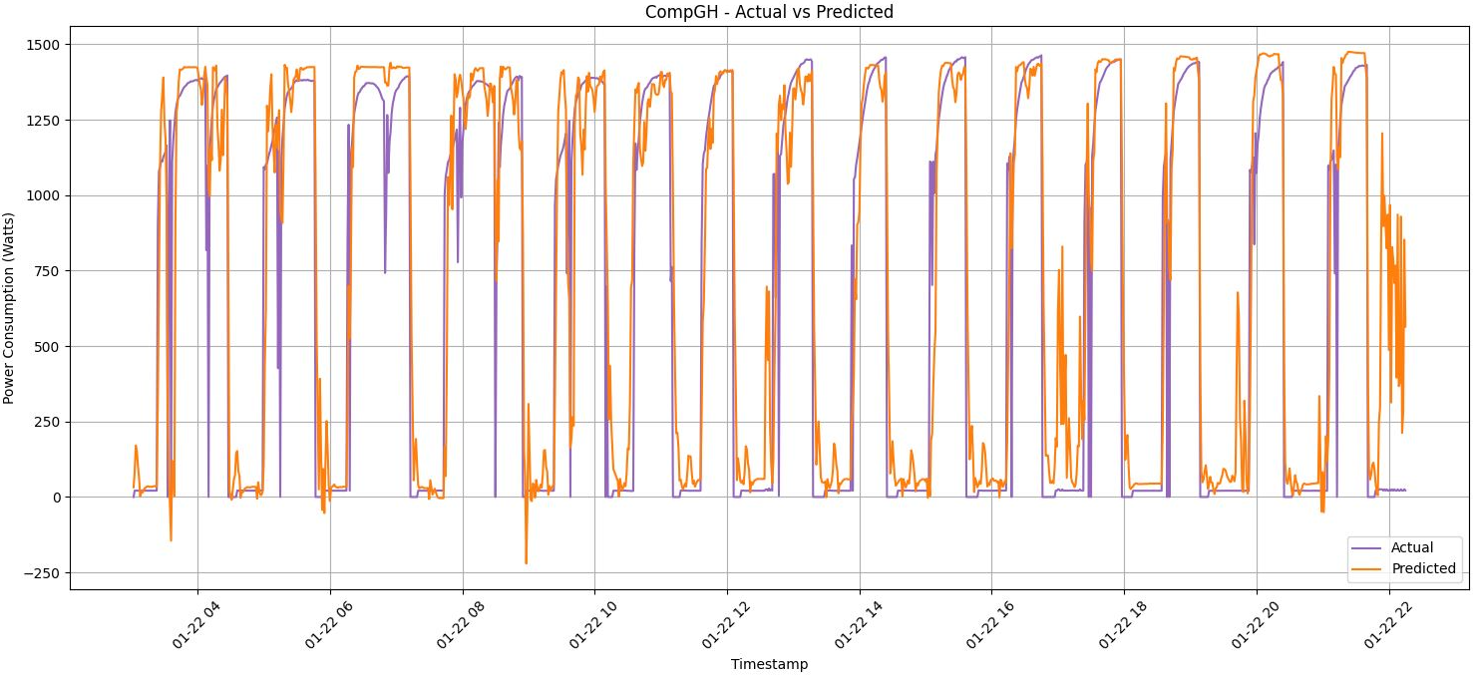
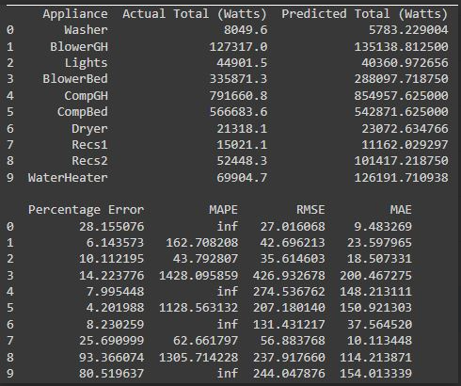
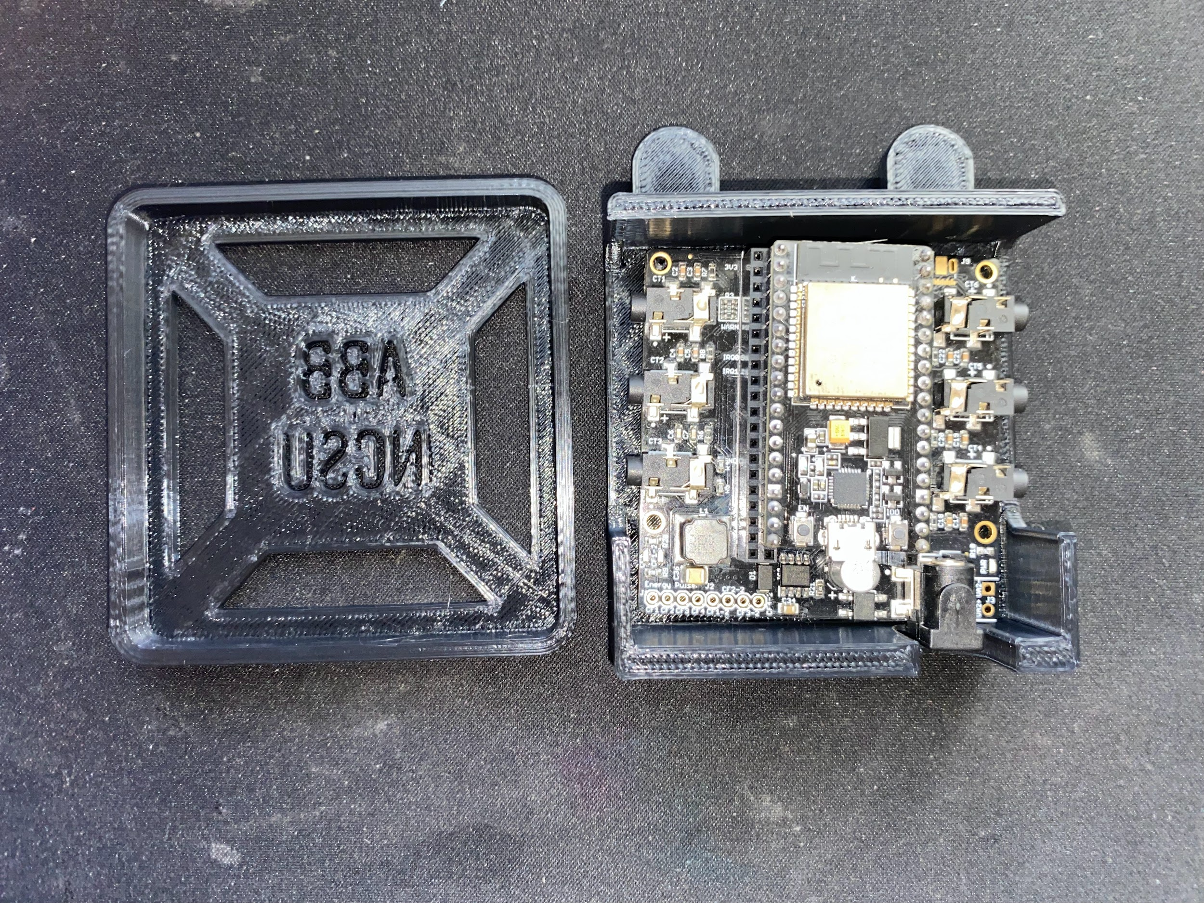
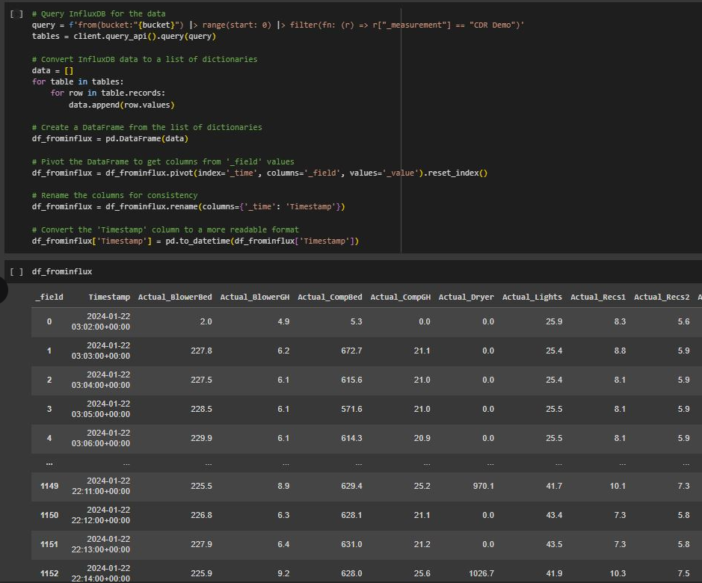
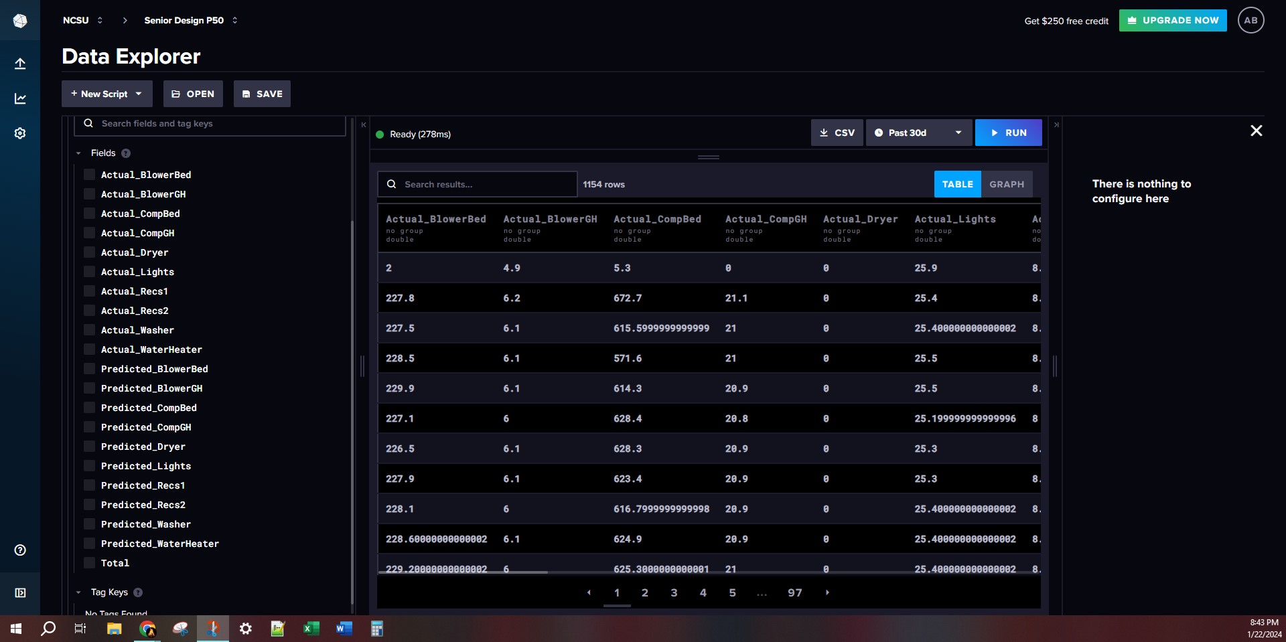
Andrew
Predictions made using ML model
Error Calculations
Images
Enclosure that can fit in a breaker box
Reading and writing data from InfluxDB

Slide 11
Questions
and
Discussion
Notes:
Slide template from slides.com

